Slide 1
Vincent HELOIN
LCLSII - Project Cryogenics Group Leader
Education & Experience

Slide 2
I- EDUCATION
II – Project Coordination of Air Separation Units construction in Eastern countries.
III - Project Engineer at Air Liquide Advanced
Congo
Bulgaria
France
Notes:
Brief Statement of what what I am today

Slide 3

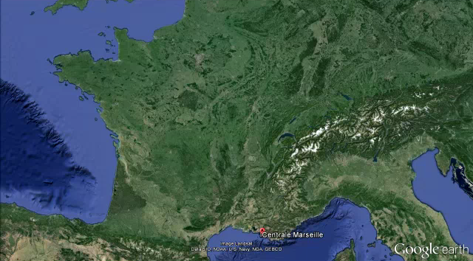

EDUCATION
Master in engineering
https://www.centrale-marseille.fr/fr
Ecole Centrale Marseille (2004)
French
Master degree in chemical engineering specializing in :
Industrial chemistry
Process engineering
Project management
Notes:
I graduated from postgraduate engineering school

Slide 4

On-site Project Coordinator
3 Air Separation Units
mid-2005 → 2008
Technical Coordination of 3 ASUs in eastern countries
Pirdop -> Bulgaria
Calarassi -> Romania
Pernik -> Bulgaria

Slide 5
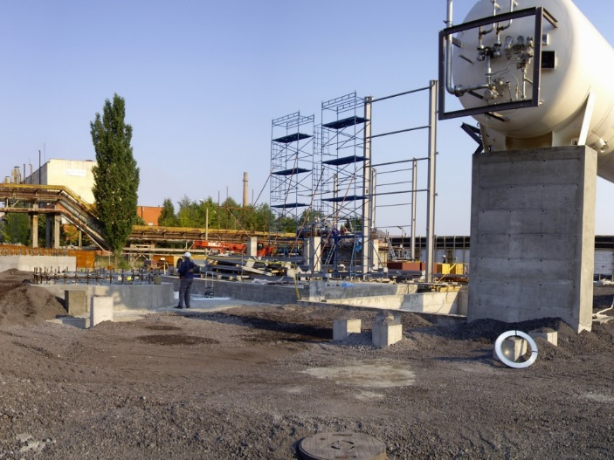
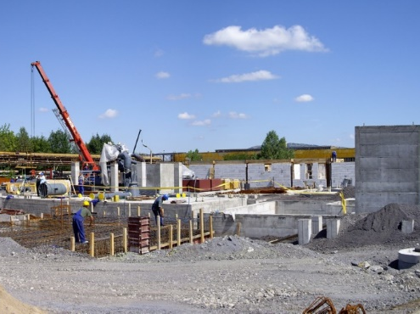
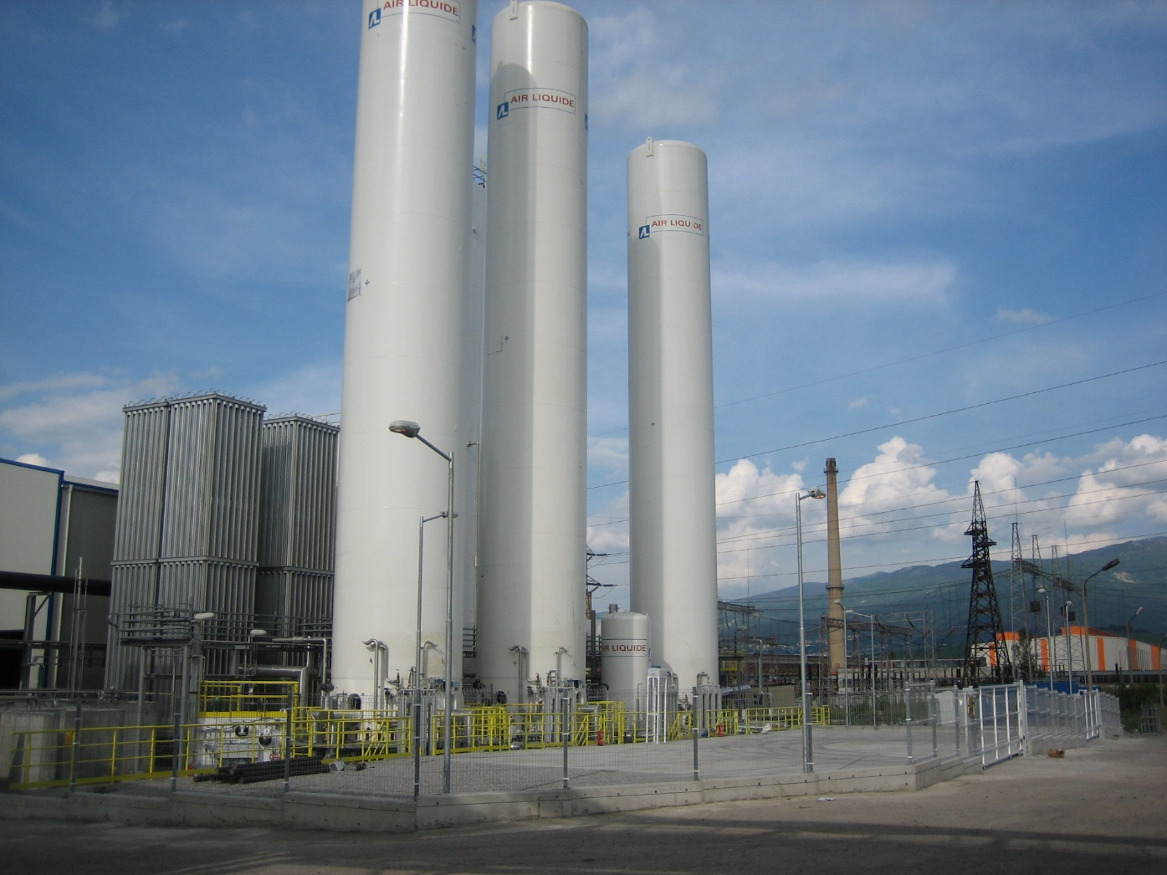
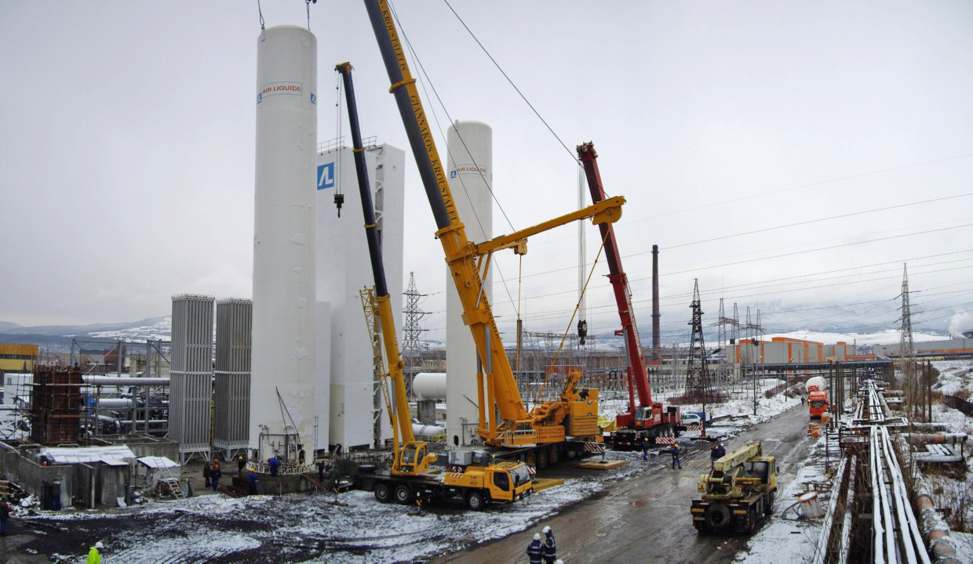
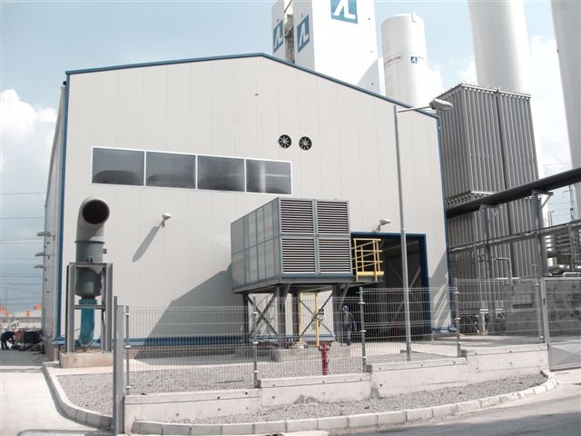
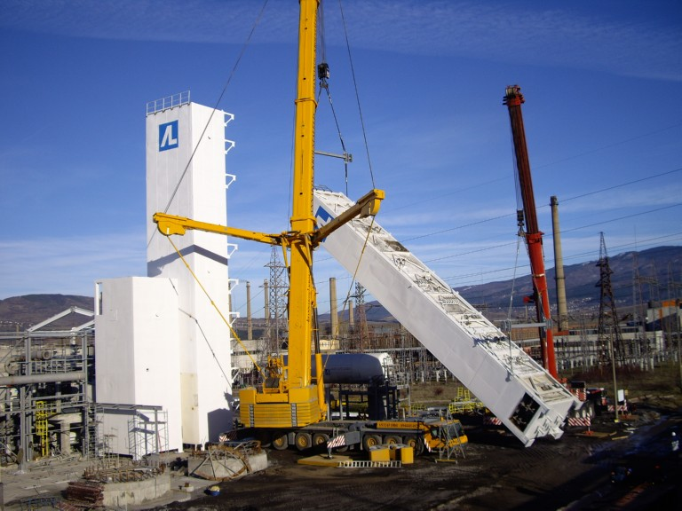
On-site Project Coordinator
BULGARIA - Pernik
Product | Flow (Nm³/h) | Flow (TPD)
Liquid O2 | 2050 | 70
Gas O2 | 6200 | 210
Gas N2 | 100 | 3
Liquid N2 | 2600 | 77
Liquid Ar | 280 | 12
Basic Engineering
  ALE India – for ASU unit
  ALE Champigny – integration ASU+storages
Detailed Engineering
  Local Bulgarian company

Slide 6
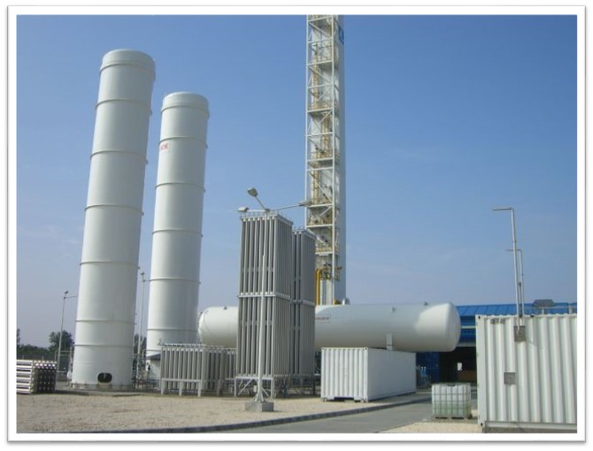
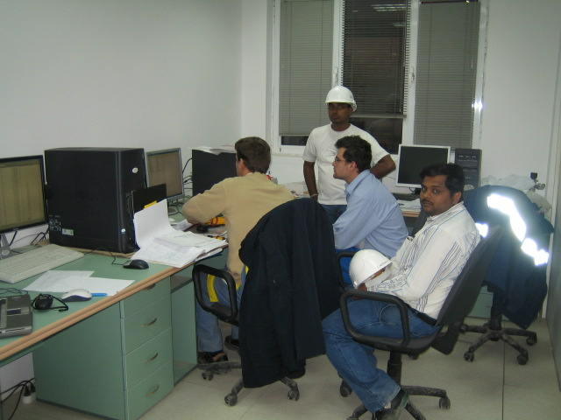
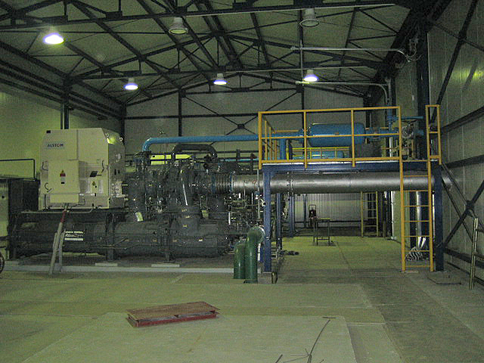
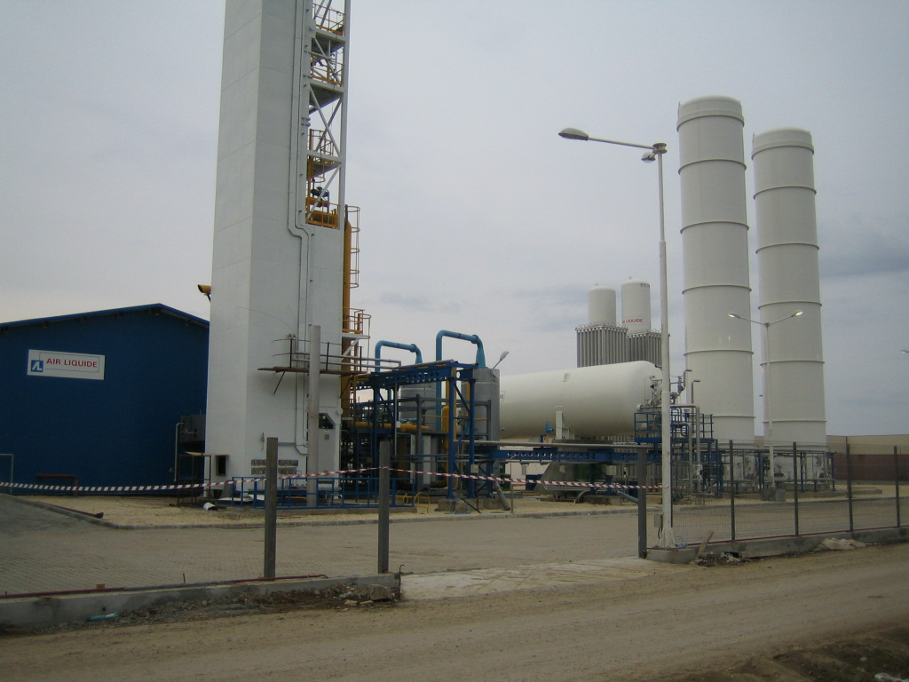
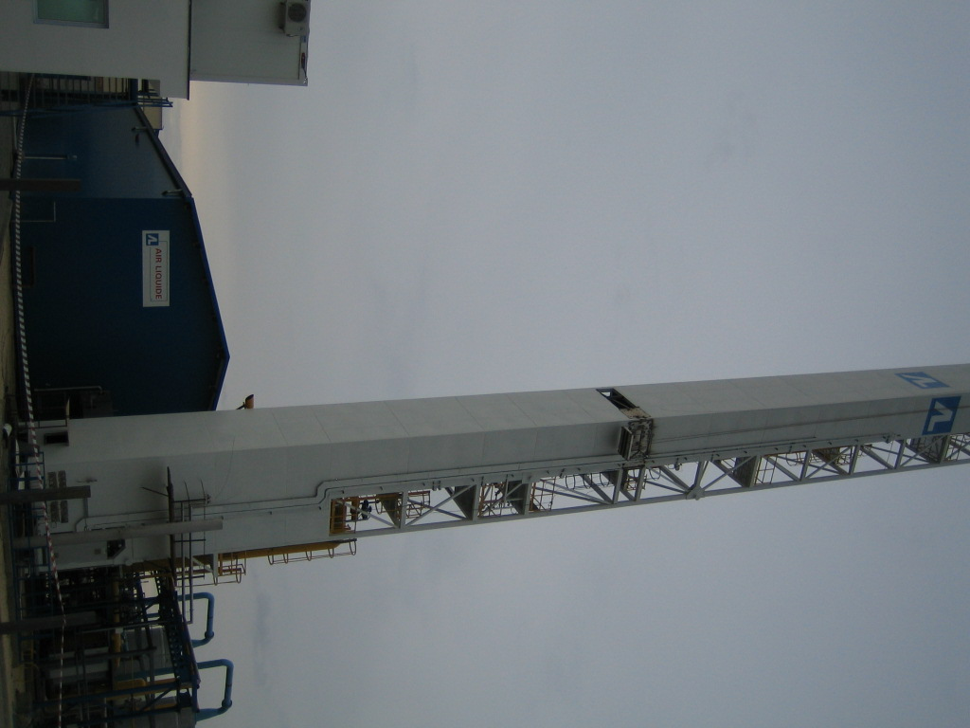
On-site Project Coordinator
ROMANIA - Calarassi
Product | Flow (Nm³/h) | Flow (TPD)
Liquid O2 | 1770 | 60,7
Liquid N2 | 315 | 9,5
Gas N2 | 3900 | 117
Gas H2 | 2x60 | 0,3
Basic Engineering
  AL India – for ASU unit
  AL Vitry – for HYOS units (Hydrolysers)
  AL Champigny – integration ASU+Hyos+storages
Detailed Engineering
  AL Romania

Slide 7


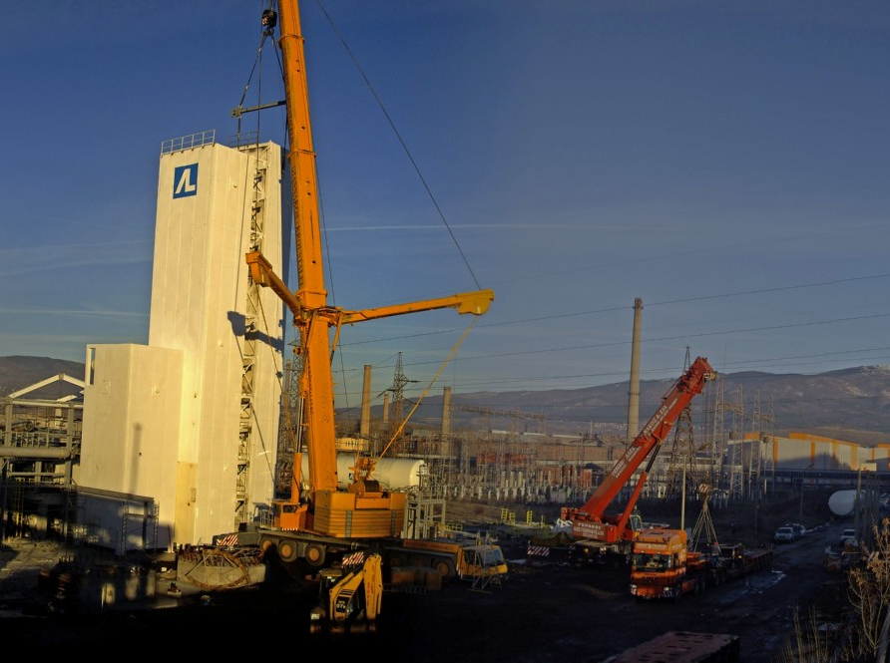

On-site Project Coordinator
3 Air Separation Units
PLANT CAPACITIES
PLANT CAPACITIES
Projects Coordination
Project scheduling & reporting.
Coordination of local team, sub-contractors and suppliers
Simplify communication with French engineering
Procurement and Expediting follow-up
Follow-up of on-site required modifications
Work independently and in a team
Work efficiently in a stressful multi-cultural environment
Existing Units follow-up
Improvement of the maintenance plan and associated procedure
Implementation of Air Liquide safety rules and standards
Management of required design modifications
Notes:
Suscessful work in a stresssfull environnment.
Scheduling follow up
Quality / Claims justification initiated

Slide 8
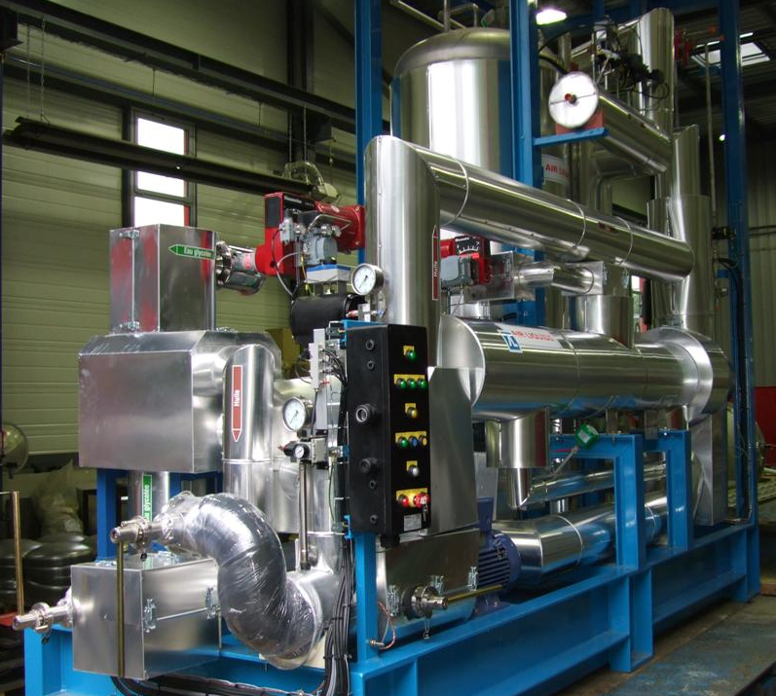
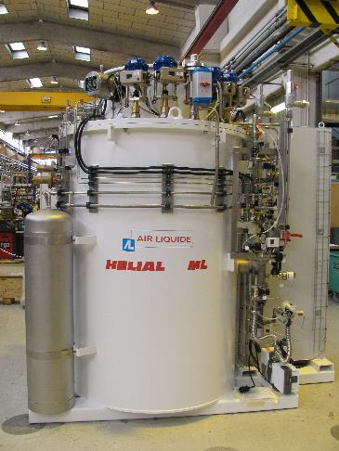
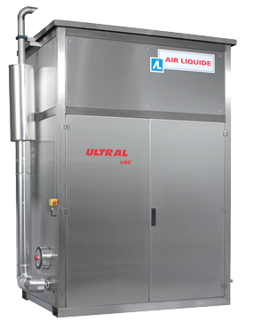
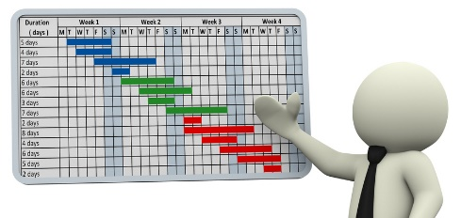
Project Manager (08 to ~10)
Various Gas & Cryogenics products
Various gas & cryogenic projects
JT60SA Pre-study (2009)
Helium Liquefier
Notes:
Alaska & co : 6 months projects .. Cost ~300 k€
JT60SA duration ~ 6 mo / 150 k€
Hefei : 1 year (w/o install & com) ~1,2 m€

Slide 9

Project Manager
Various Gas & Cryogenics products
PLANT CAPACITIES
PLANT CAPACITIES
Main Skills used / developed
Customer / contract management
Team Management (Technical, purchasing, expediting)
Scheduling
Budget
Cost Estimation (Helials, Qatar II, JT60SA, ITER LHe Plant)
Notes:
Increase profitability of all projects.

Slide 10

Project Engineer
Helium liquefiers/refrigerators
Main Skills used / developed
Helium Liquefaction / Refrigeration Process
Thermal / Hydraulic calculation
Equipment specifications (compressors, valves, instruments,…)
Functional Analysis
Helium Liquefier commissioning

Slide 11
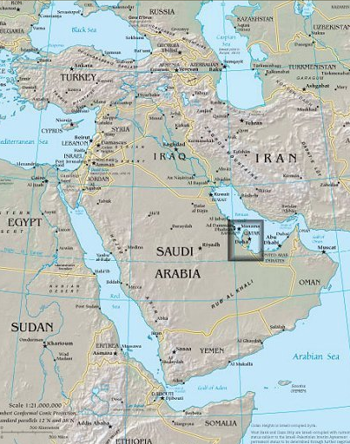
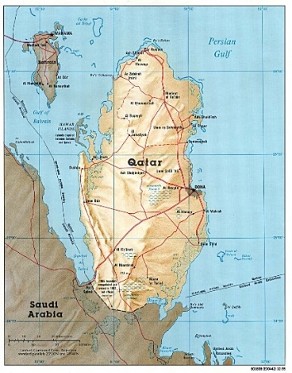
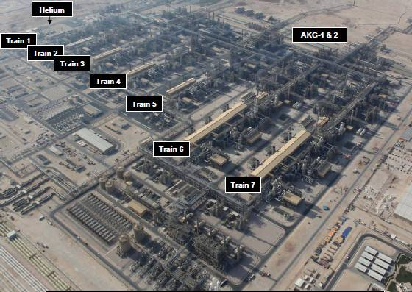

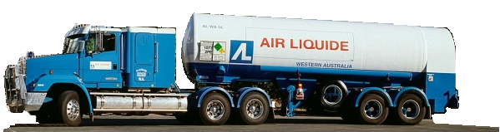

Project Engineer – Large Helium Project
RHEA Liquefier (20t/d) – Ras Laffan, Qatar
NATURAL GAS (215000 TPD)
Helium ~ 0.1%
CRUDE HELIUM:
(50%He, 48%N2, 2%H2, Ne)
He Recovery Unit II: AIR LIQUIDE Engineering Scope
PURIFICATION System:
Compression
Partial Condensation
Hydrogen Removal
PSA Purification (~150ppm)
LIQUEFACTION System:
Compression
Purification (~5ppm)
Liquefaction
LOADING Bays:
Storage: 480m³ Liquid
4 Loading Bays
LHe 20 TPD
ASU: LN2 for LIN Shield

Slide 12
Project Engineer – Large Helium Project
RHEA Liquefier (20t/d) – Ras Laffan, Qatar
Liquefier 7000l/h, 20TPD loaded, 27kW @ 4,5K equivalent power:
(2x2) Compressors : 3 Pressure levels
6 static gas bearing expansion turbines
No LN2 Precooling
Push-pull 80K & 20K adsorbers
4x Fixed Storages of 120 m3
Liquefier adapted to process load variation from trucks:
Truck depressurization
Truck cooling down
Truck loading

Slide 13
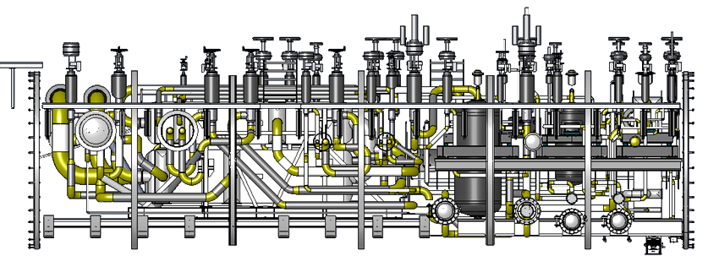
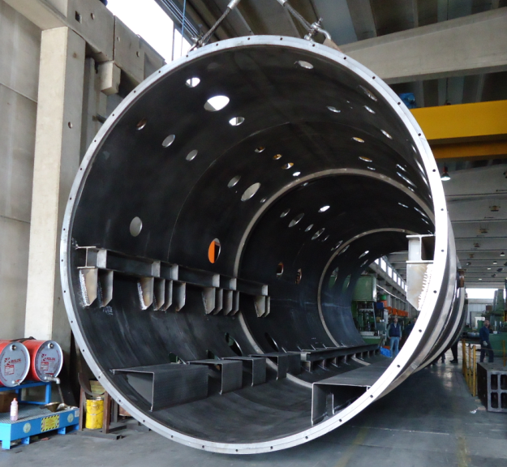
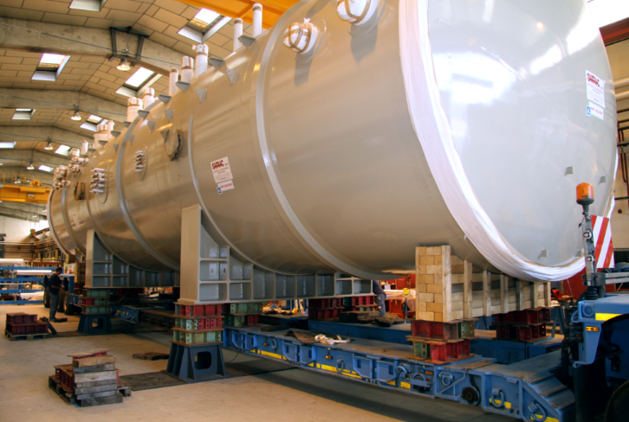
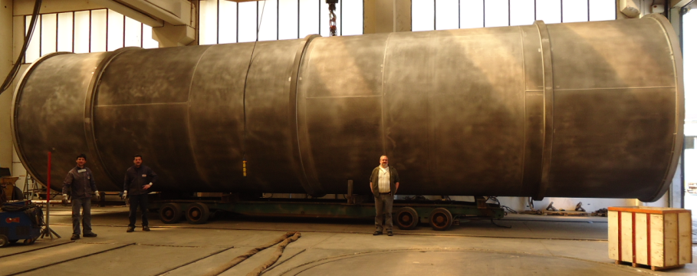
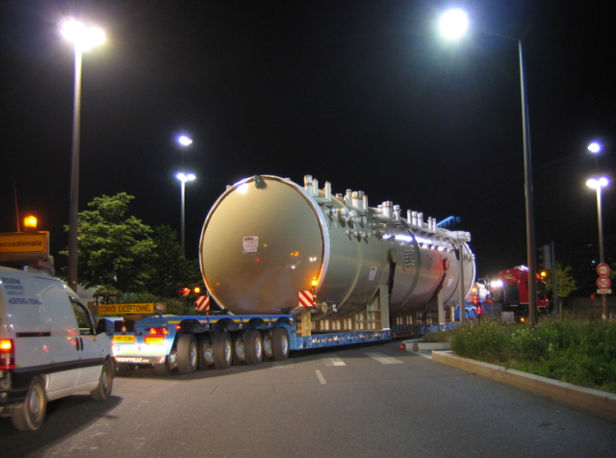

Project Engineer – Large Helium Project
RHEA Liquefier (20t/d) – Ras Laffan, Qatar
4,2m
17m with ends

Slide 14
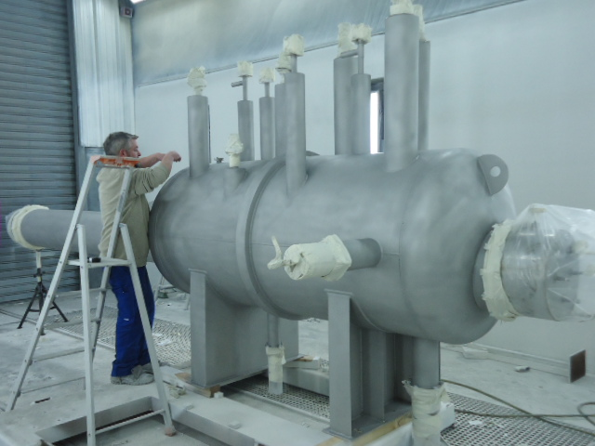
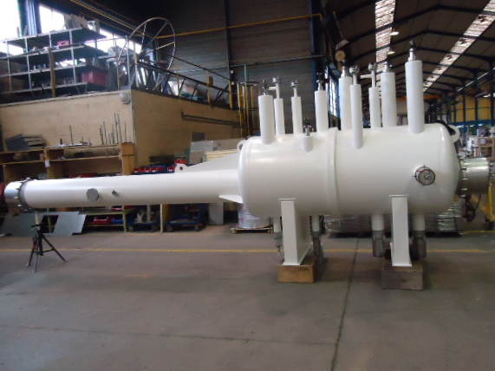
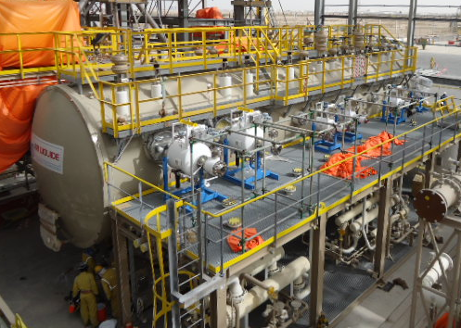
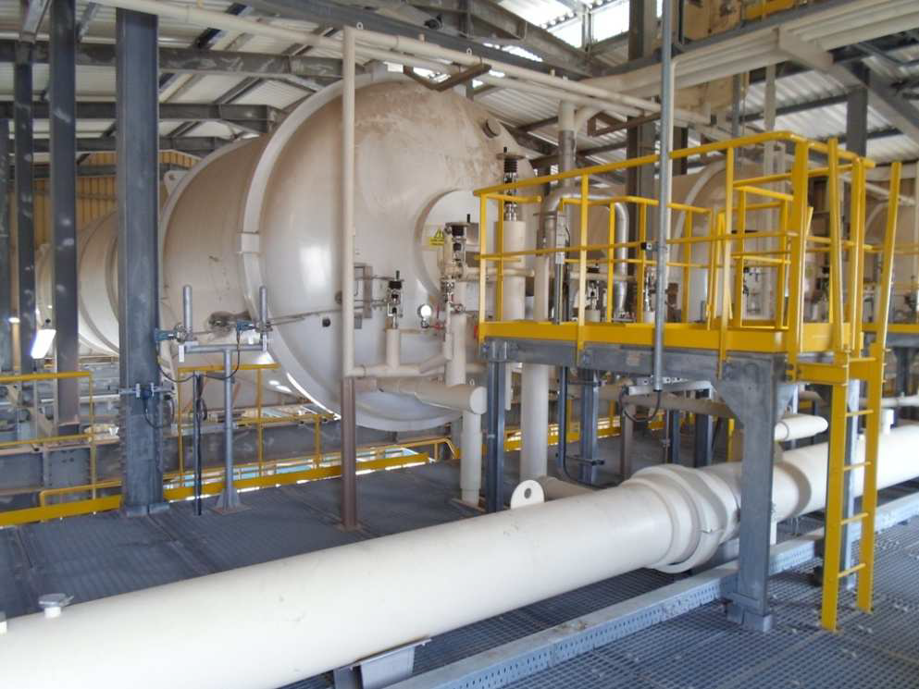
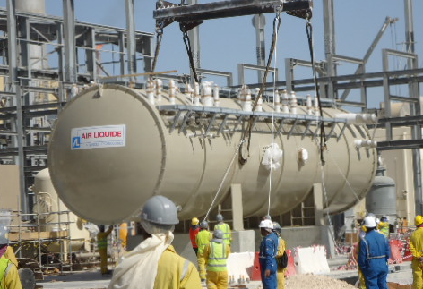
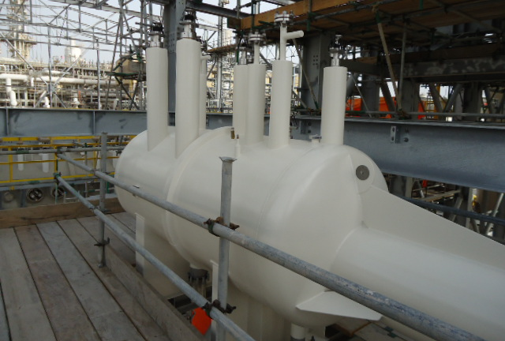
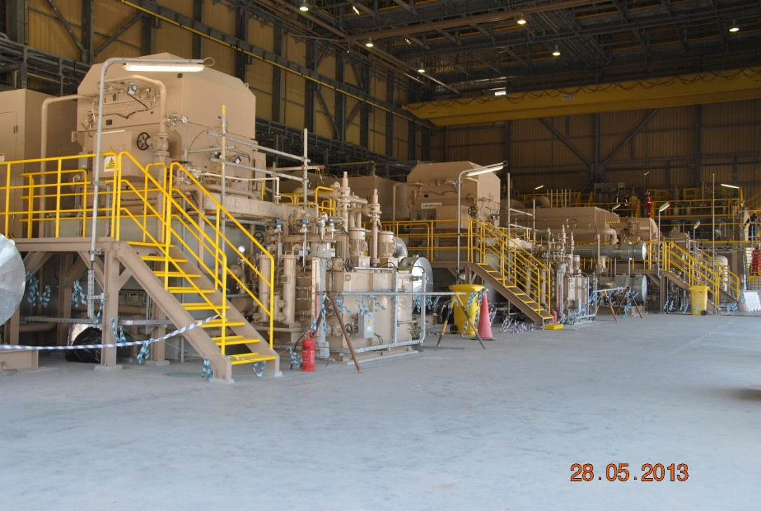
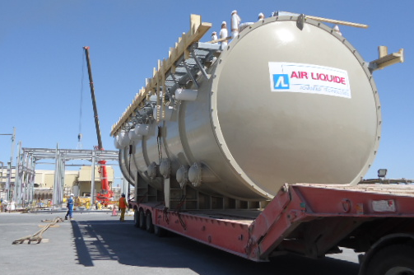
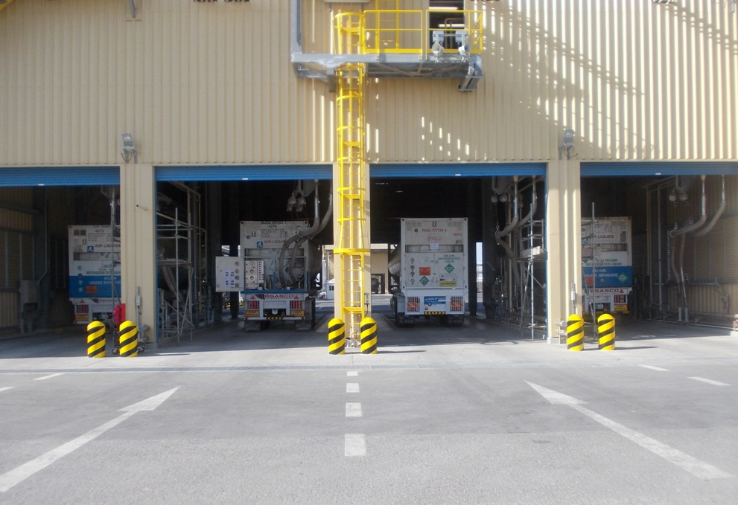
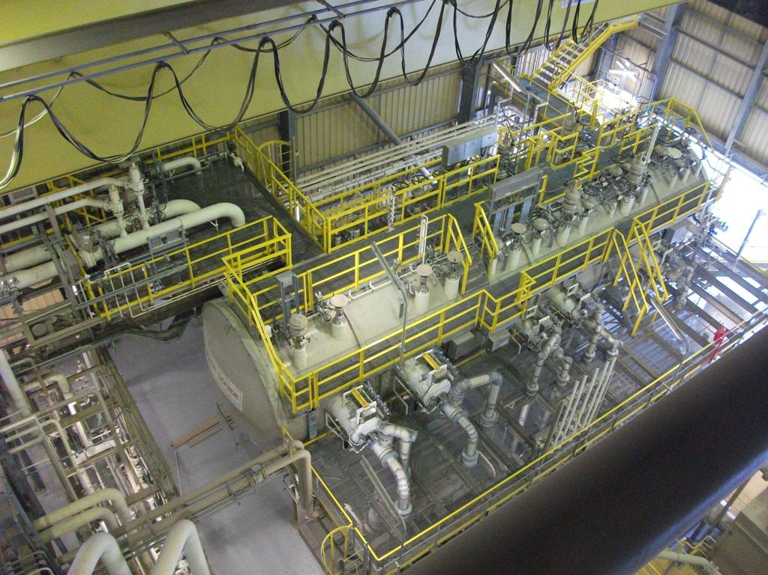
Project Engineer – Large Helium Project
RHEA Liquefier (20t/d) – Ras Laffan, Qatar
Main Skills Developed
In charge of basic design of the distribution
Sub-contrators selection & follow-up
Equipment specifications/selection (valves, instruments,…)
Participation at HAZard and OPerability study)
Operators training
Performances tests

Slide 15
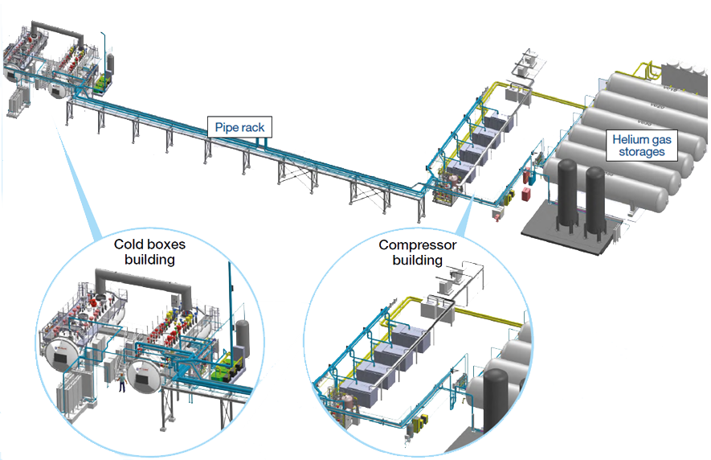



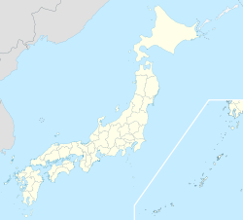
Project Engineer – Large Helium Project
JT60SA (9kW@4,5K) - Japan
PLANT CAPACITIES
PLANT CAPACITIES
Helium Cryogenic System
  AL-AT’s contractual customer: CEA (France)
  Final User: JAEA (Japan Atomic Energy Agency)
  Other stakeholder: F4E (Fusion For Energy)
Naka
Osaka
Tokyo

Slide 16
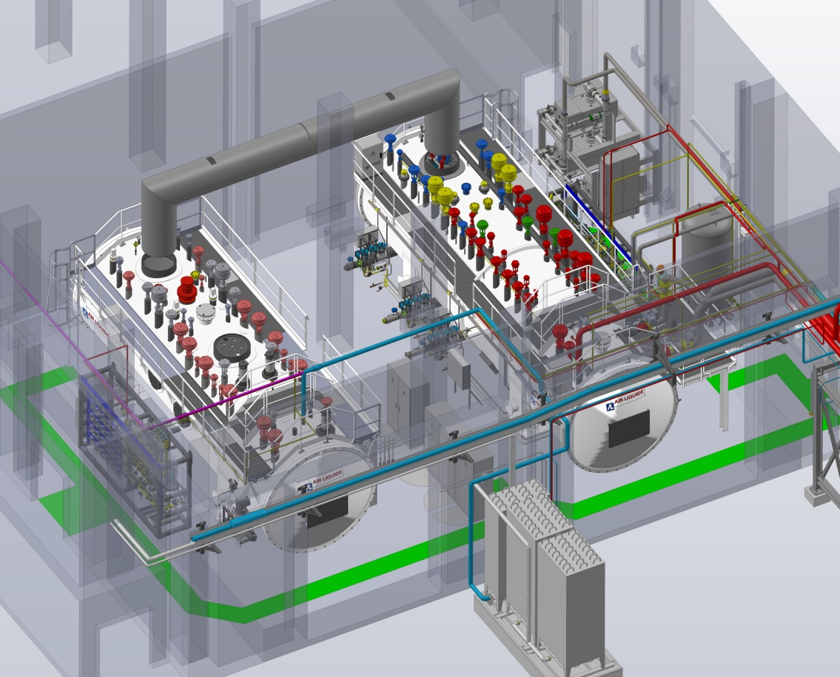
Project Engineer – Large Helium Project
JT60SA (9kW@4,5K) - Japan
PLANT CAPACITIES
PLANT CAPACITIES
Cryogenic Hall
PFD
Scope of Supply
ATM
Warm Compressor Station
  Sub Atmospheric Pumps (VLP-> HP)
  Helium Cycle Compressors (LP -> HP)
  Final Oil Removal System (ORS) & Dryer
Refrigeration Cold Box (RCB)
Ø3.2m, L=12m, Weight=65t
  Warm Panel
  LN2 precooler
  3 Turbo expanders
Auxiliary Cold Box (ACB)
Ø3.2m, L=11m, Weight=60t
  Warm Panel
  3 Cryo Rotating Machines
  Test Heaters
Others
  Multi Line RCB <-> ACB Ø1m, L= 12m Interconnections piping and supports
  Control system & Electricity
  On site installation (no civil work)
MULTILINE (Ø1m)
HTS
TS
LIN
TURBINES
14m
CRYOMACHINES
RCB
ACB
20m
TF
CS + EF
Circuit 3

Slide 17
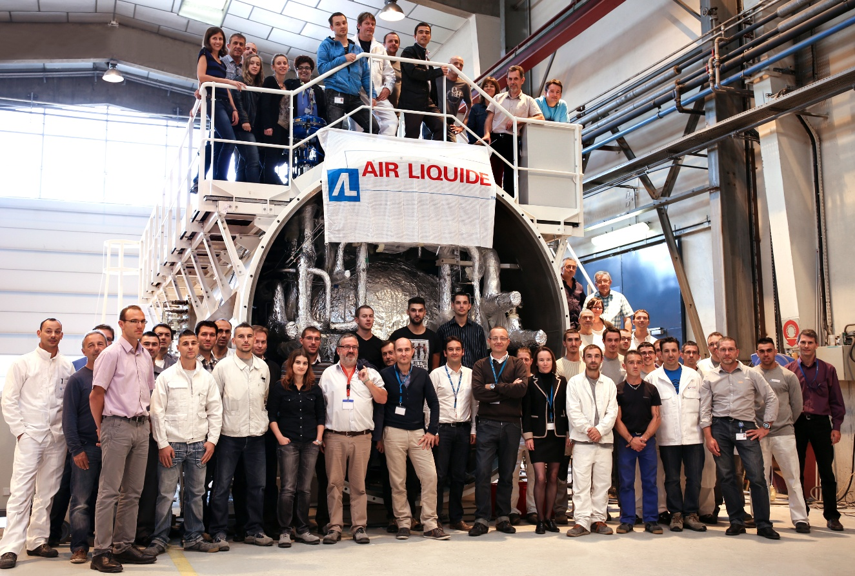

Project Engineer – Large Helium Project
JT60SA – Lead Project Engineer
PLANT CAPACITIES
PLANT CAPACITIES
July 2011 : 1st customer specification
  Nov 2011 : First Proposal
  Janv 2012 : Second proposal
June 2012 : Final Customer specification
  End of June 2012 : Final proposal
Nov 2012 : Customer Purchase order
Technical Proposal: 8 Months
Proposal Review: 4.5 Months
Engineering & Manufacturing: 21 Months
Transport & Stand-by: 6 Months
Construction : 6 months
Commissioning : 10 months
Nov
2011
June
2012
Nov
2012
Oct 2014
April 2015
Oct 2015
August 2015
April 2015 : Installation Start
August 2015 : Performance Test

Slide 18
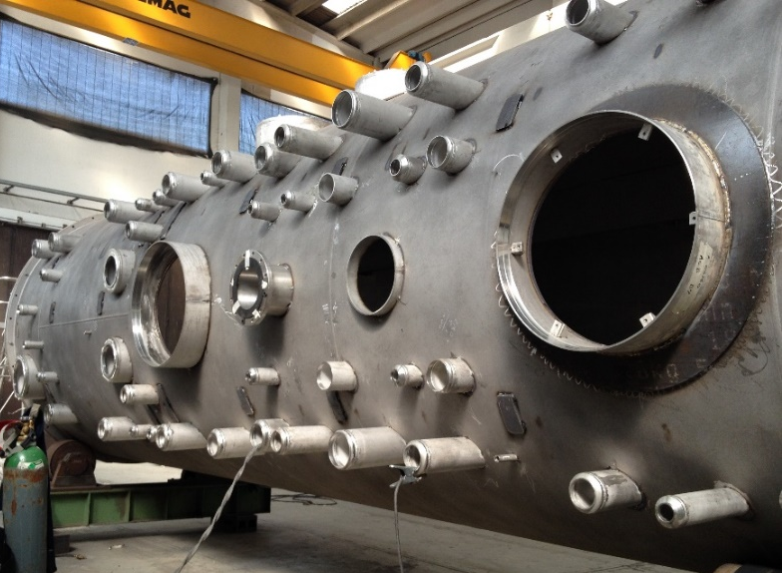
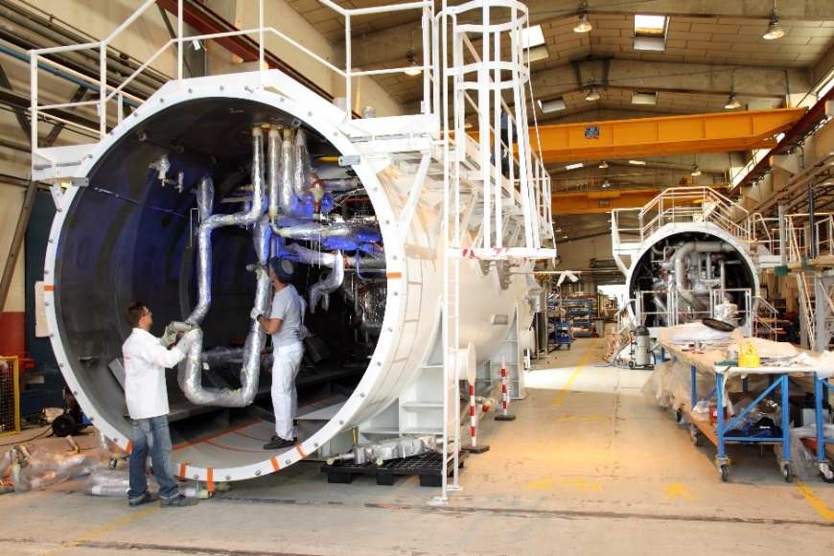
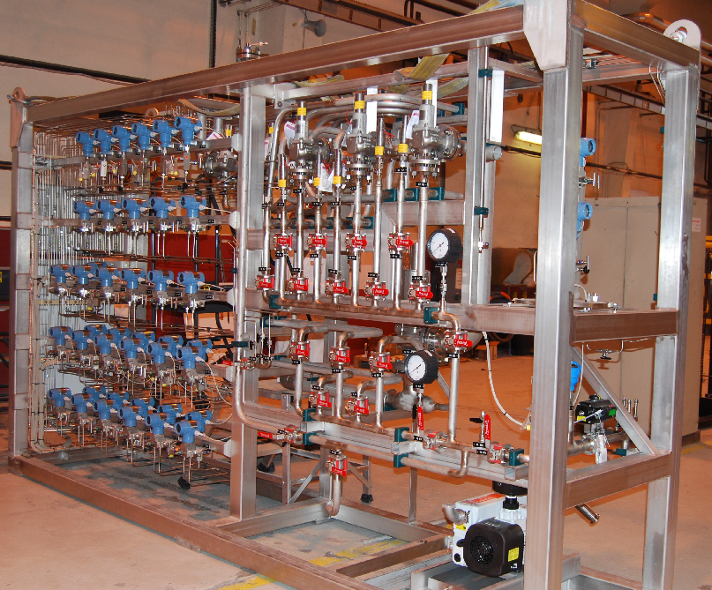
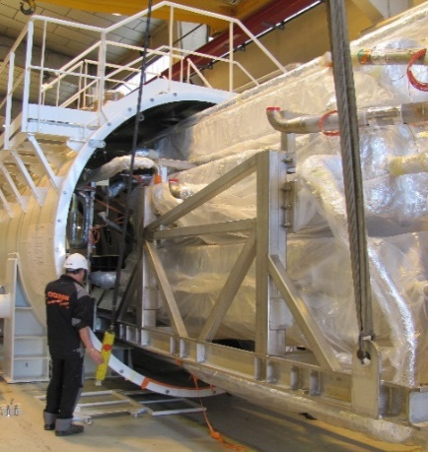
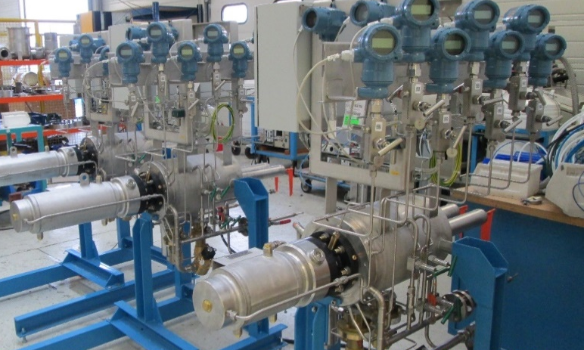
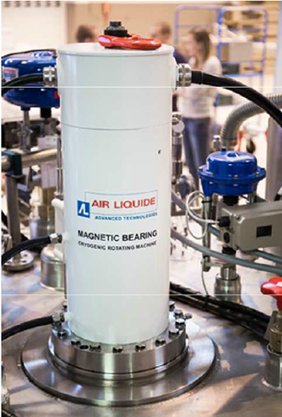
Project Engineer – Large Helium Project
JT60SA (9kW@4,5K) - Japan
PLANT CAPACITIES
PLANT CAPACITIES

Slide 19
Project Engineer – Large Helium Project
JT60SA (9kW@4,5K) - Japan
PLANT CAPACITIES
PLANT CAPACITIES
Main Skills Developed
Proposal engineer
Lead & manage engineering team
In charge of all technical discussion with customer
Developed the functional analysis of the system
Frederic Michel (PM CEA) & Me
Notes:
Deicisons.

Slide 20


LCLSII - Project Cryogenics Group Leader
Thank You for your attention.

