Slide 1
Design To Cost
Product Overview
Sassenage, 28/03/2015 l

Slide 2
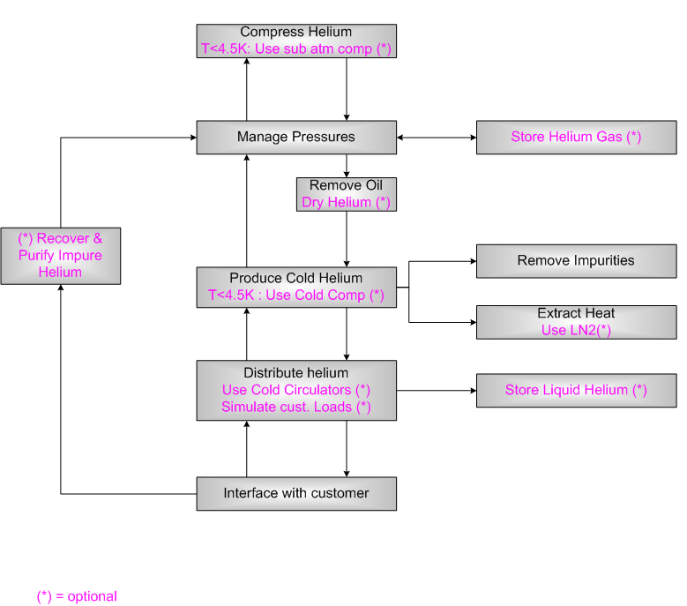
OVERALL FUNCTIONAL ANALYSIS

Slide 3
FUNCTIONAL ANALYSIS

Slide 4
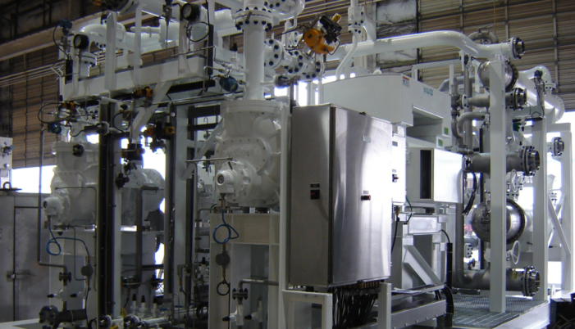
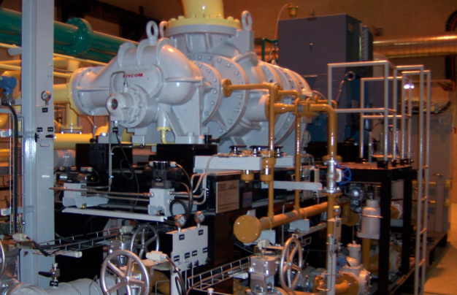
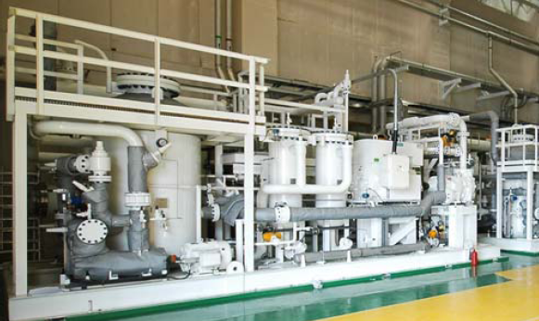
Screw Compressor
Skid Assembly :
- Motors
- Screws

Slide 5
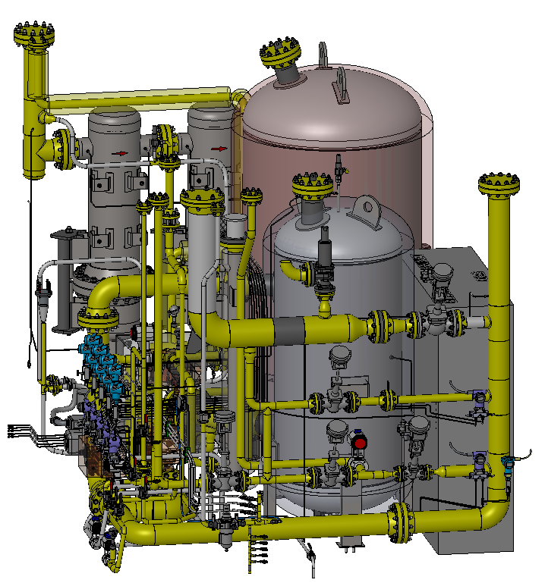
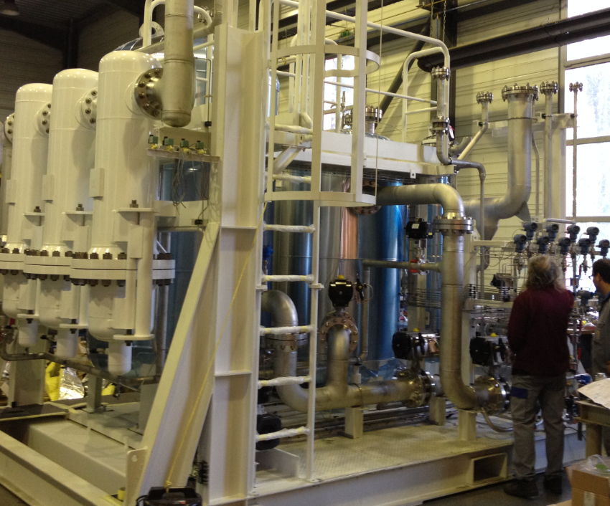
Oil Removal System (incl pressure control valves)
Charcoal Tower
Coalescers
Dryer
Control Compressors Pressures

Slide 6
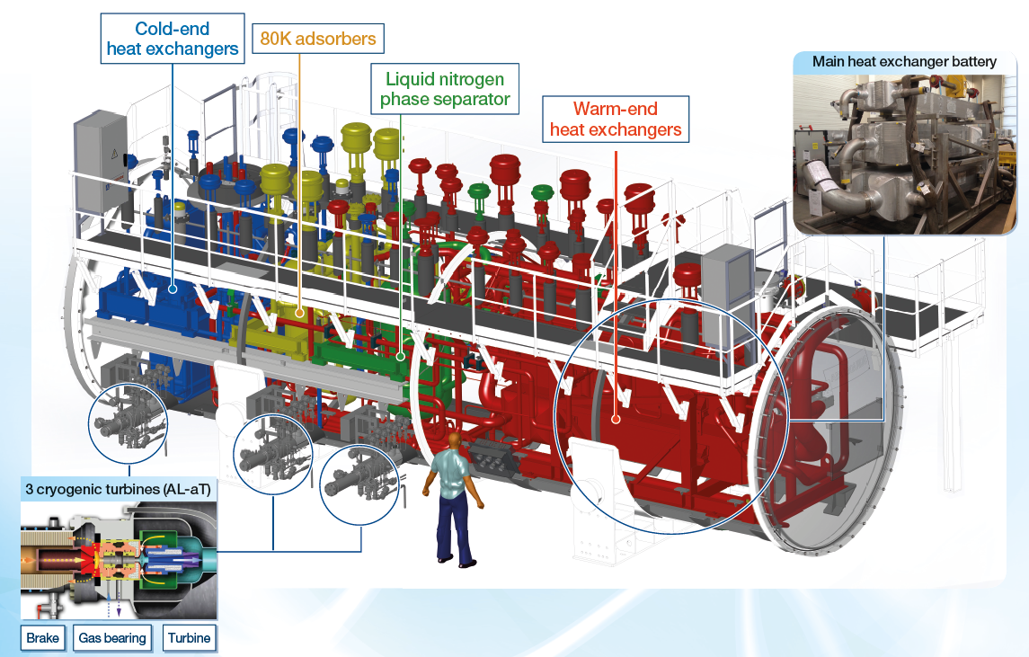
Cold Box (Ø~3m, L~12m)
Nota: In this project, we use LN2 precooling (less turbines)

Slide 7
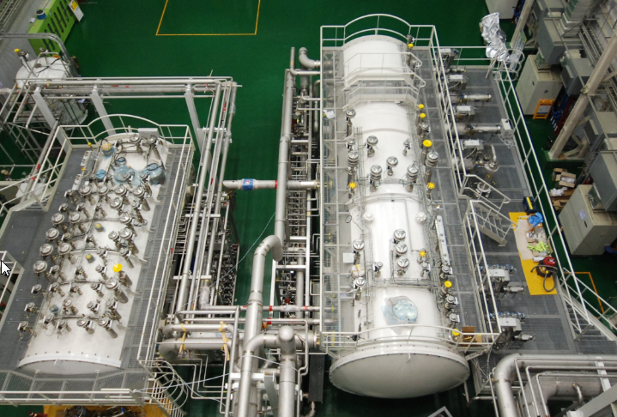
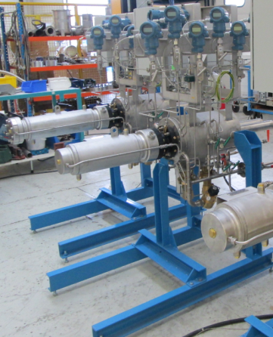
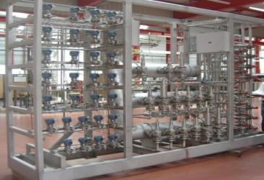
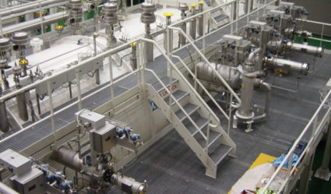
Cold Box + Distribution box
6 Turbines
Nota : Distribution box is not always needed

Slide 8
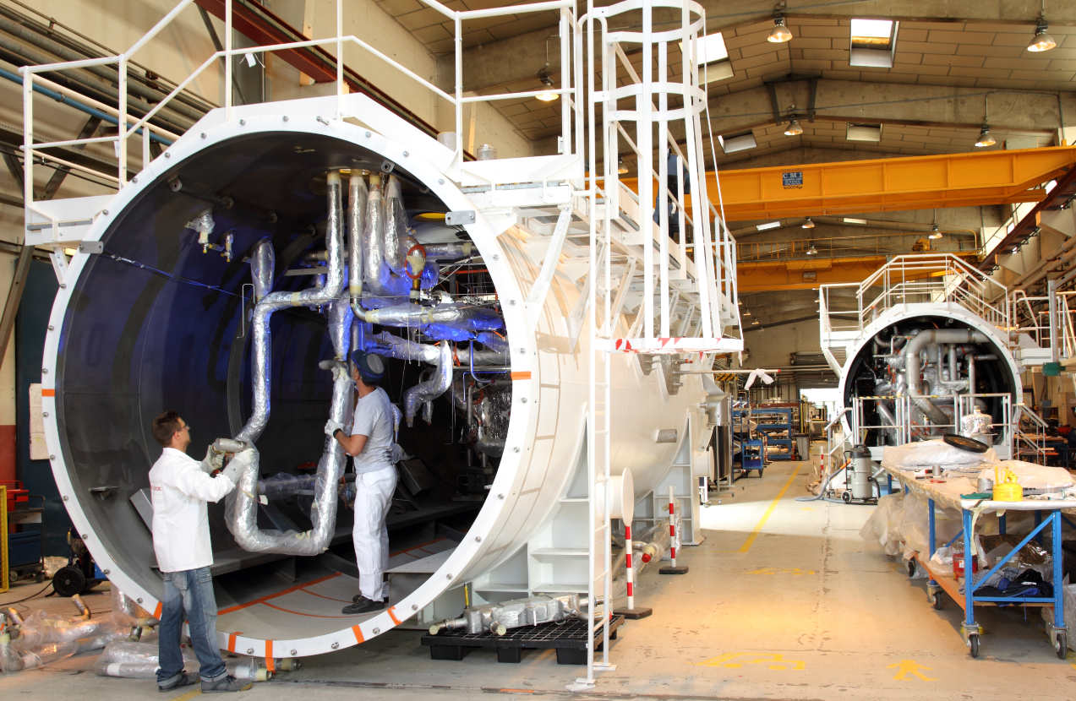
ALAT Manufacturing (Ø~3m, L~12m)

