Slide 1
Air Liquide
Design to Cost : Design Case
Sassenage, 02/2015 l VINCENT HELOIN

Slide 2
He Cycle Buffer
Cycle Compressors
PURIFICATION
Gas Bag / Recov.comp / Impure storage / Purifier
VACUUM
Cold Boxes
COLD STORAGES
MULTILINE

Slide 3
Cycles Compressors
VLP

Slide 4
He Cycle Buffer
PURIFICATION
Gas Bag / Recov.comp / Impure storage / Purifier
Cycle Compressors
VACUUM
RCB
LN2 STORAGE
SUB ATM COLD BOX
ACB
LHE STORAGE
MULTILINE

Slide 5
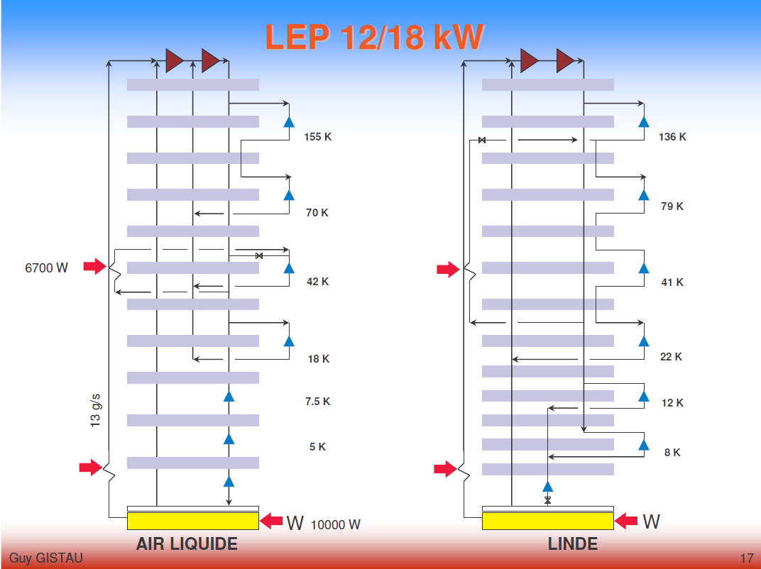

Slide 6
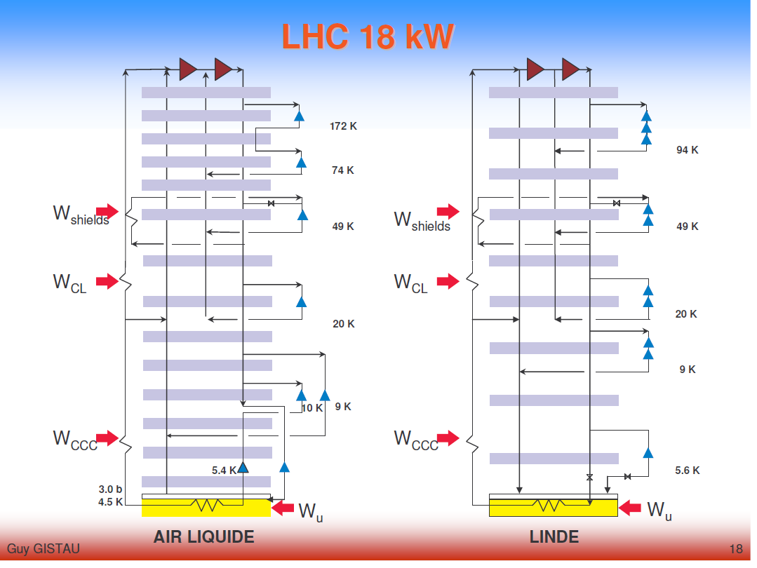

Slide 7
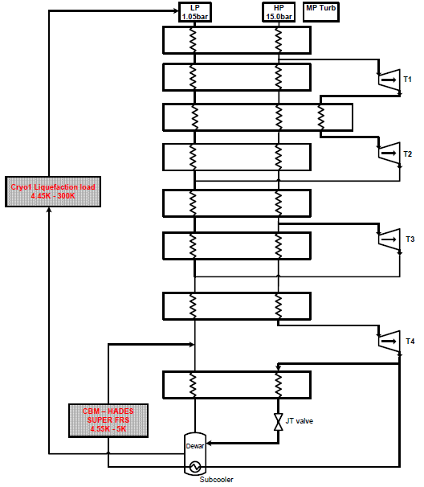
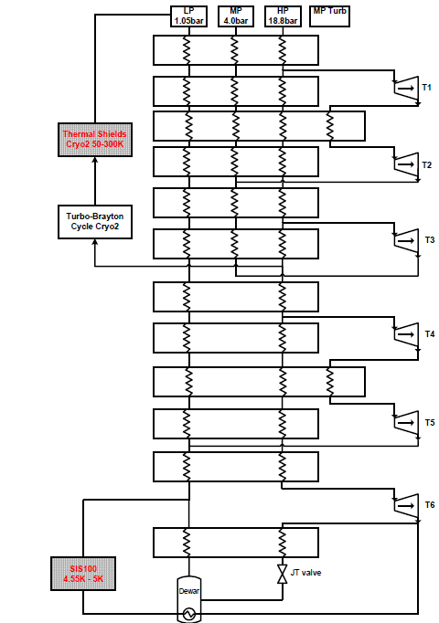
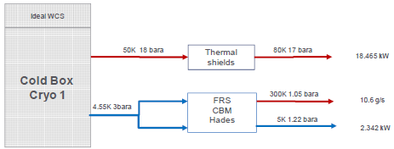


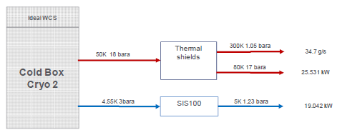
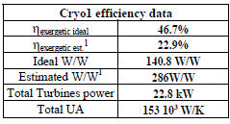
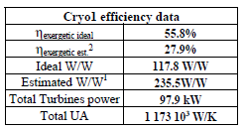
GSI

Slide 8
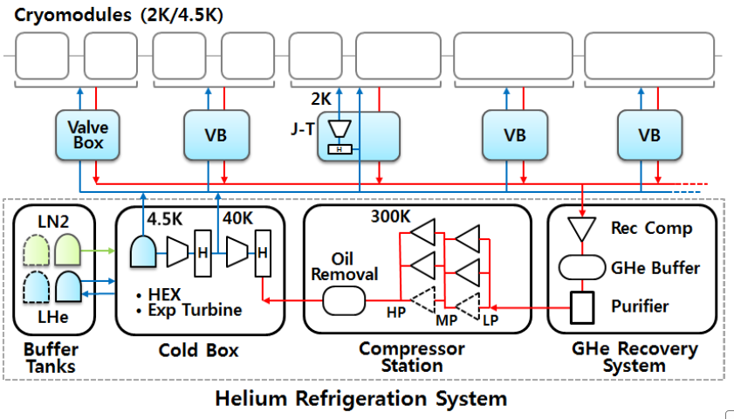
IBS = ESS
recovery system : could be option
compressor station
cold box
Liquid helium storage
LN2 Storage
Valve box with 2K ?
3,3kV
Could be option

Slide 9
