Slide 1
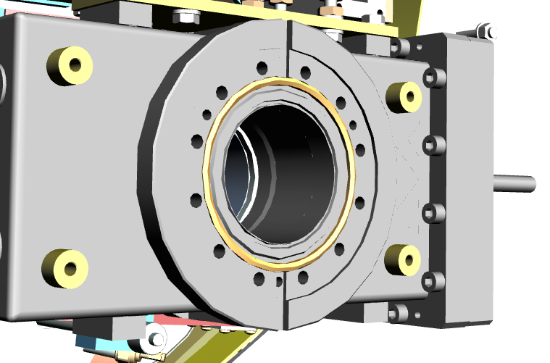
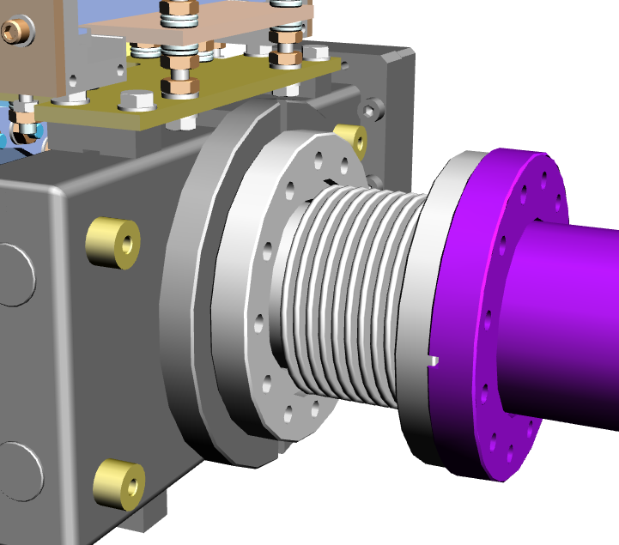
Distance measure from
1 - The body where fiducial are located ?
2 - From the flange (outside) ?
3 - From the flange (contact Surface) ?

