Slide 1




Cryogenics
Applied Technology Development
Dana Arenius, Rao Ganni
Engineering Division
Cryogenic Systems Department
Technology Town Meeting
Feb 9, 2012
This work is supported by the United States Department of Energy (DOE) contract #DE-AC05-060R-23177

Slide 2
Presentation Outline
Technology Development Sources
Focus Goals and Status
Funding Sources
Technology Outreach
Status of Current Collaborations
Summary

Slide 3
Sources for Technology Development
DOE Laboratory Community
  Cryogenics Operational Workshops
    (attended by Industry and physics research labs world wide)
  JLab operational experience and needs
  Other DOE laboratory cryogenic collaborations to retain and develop cryogenic engineering technology and personnel
Cryogenic Engineering Conferences
Accelerator Division SRF advancements
Insight of where industrial developments ended

Slide 4
Development Focus Goals
Establishing the use of Jlab’s Ganni Cycle by the end user and industry for existing and new plants
Reducing utilities used by helium refrigerator plants in terms of electric power, cooling water, and LN2
Improved helium plant reliability with less maintenance
Conservation of helium (reduced helium gas loss) and the means of recycling helium for use (i.e. recovery purifiers)
Warm helium compressor efficiency improvement coupled with reduced capital equipment cost via a standard compressor skid design model
Development and retention of qualified engineers and designers in support of cryogenic technology in the DOE community

Slide 5
General Focus Status
Ganni Cycle implementation in a number of plants
Floating Pressure Technology use for existing plants
Improved LN2 pre-cooling technology developed
JLab’s SNS 2K system design is demonstrating low helium operational gas loss technology, ~$10K per year, ½ plant size of Jlab
Standard helium compressor design model in place
Combined He plant/cryomodule design optimization approach, (MSU funded CM 2K heat exchanger configuration test, further power reduction over current 12 GeV design)

Slide 6
Process Cycle Technology Use So Far
Existing Plant Conversions (Partial Ganni Cycle i.e. Floating Pressure )
Jefferson Lab...all six refrigerators, 2K/4K, 200 to 4.6 kW
Brookhaven RHIC ….Central Helium Liquefier
Spallation Neutron Source (SNS)…CHL, 2.3 kW @ 2.1K
Michigan State University….Cyclotron Test Facility
NASA Johnson Space Center, Environmental Test Chamber A, twin 3.5 kW 20K refrigerators
New Facilities (Full Implementation of Ganni Cycle)
Jefferson Lab 12 GeV Upgrade, 4.6 kW @ 2.1K
Jefferson Lab’s 4kW End Station Refrigerator (ESR-2)
NASA JSC Houston, James Webb Telescope Test Facility, 12.5 kW @ 20K
MSU FRIB
Other Possible Facilities
  Project X, BNL Upgrade, FEL programs

Slide 7
Funding Sources
    NASA, JSC
    MSU FRIB Project
    Future MSU FRIB Operations
    SNS Operations
    JLab Accelerator Division
    JLab Engineering Division

Slide 8
Technology Outreach
Optimal Helium Refrigeration Course Instruction
  Once a year, at CEC conference or Cryogenic Operations Workshop, industry and laboratory attended
Advanced engineering degree thesis work assigned to each technology collaboration
Participation of collaborators at JLab
  currently have two MSU engineers (controls and mechanical) working with cryogenics group for one year
  Past engineers from SNS and MSU
Publications and talks

Slide 9
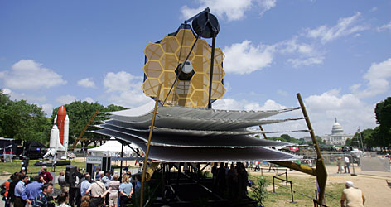
NASA-JSC/JLab Collaboration
James Webb Telescope
Space Telescope
Replaces Hubble
~1 million miles out
Telescope Mockup at the National Mall, D.C.
NASA Funded-JSC/JLab Cryogenic Collaboration
  Help NASA engineers modify Current Environmental Space Simulation Chamber cryogenic system to JLab’s Floating Pressure Technology
  Help develop specification of additional new 20K, 12.5 KW refrigerator using the Ganni Helium Process Cycle

Slide 10
NASA Design Goals
Both the existing (using Floating Pressure) and new machine (using the Ganni Cycle) to have constant high efficiency with wide range of load
The utilities used by the cycle to vary directly with the refrigeration load required
Improve existing Helium plant temperature stability

Slide 11
Benefits of the NASA Collaboration
Eliminated much of the compressor engineering/design effort for Jlab 12 GeV
First full implementation of the Ganni Cycle in a new refrigeration plant
Served to help industry develop the understanding of implementing the Ganni Cycle
Demonstrated the improvement of temperature stability in a pure refrigerator (10x over previous industrial design at NASA)

Slide 12
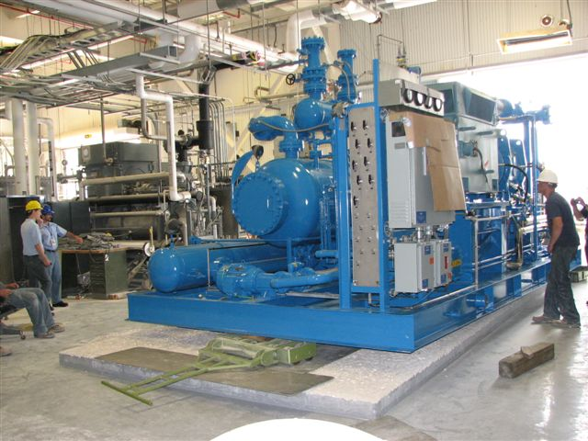
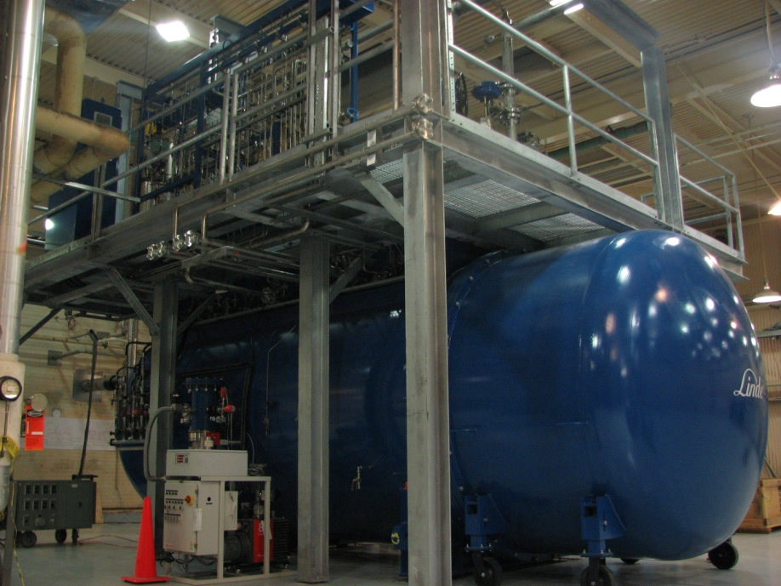
NASA 20K Refrigerator
Helium Compressors
12.5 kW, 20K Cold Box
Startup: Summer 2012

Slide 13
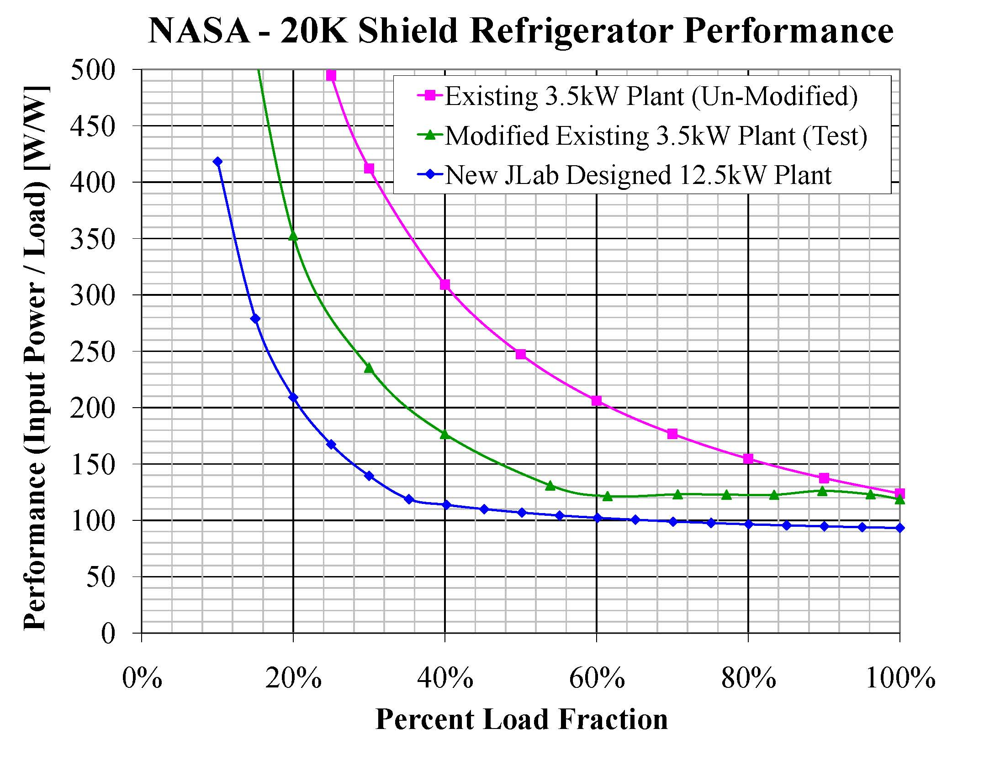
NASA Test Results and Plan

Slide 14
Recognition of “Third Dimension” with Ganni Cycle
(Wide Operating Temperature Domain)
Other Possible Domains
Other Possible Domains

Slide 15
Standard Helium Compressor Design
NASA/JSC Funded
Utilizes lessons learned from previous designs and performance
Next generation compressor skid assembly design
  Initially supports NASA James Webb Telescope Testing
  JLab 12 GeV warm helium compressors
  MSU FRIB compressors
  “Best value” design approach as evaluated by industry

Slide 16
Notable Compressor Design Features
Bulk Oil Separation Vessel
  Vessel diameters reduced 50%
  Vertical to horizontal design with specialized flow distributor
  Oil coalescer filter eliminated
  Large vessel flanges eliminated
Gas after cooler oil removal system added
Cooling oil flow adjusted with temperature
Oil hold capacity requirement by 75%
Vibration isolation for I/C and heat exchangers
Easy access to all the components requiring maintenance

Slide 17
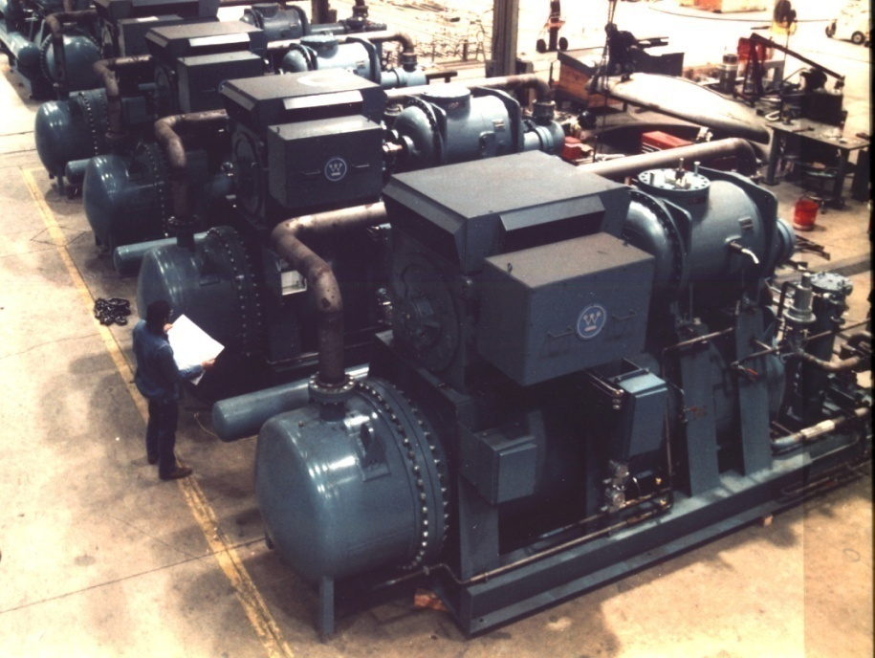
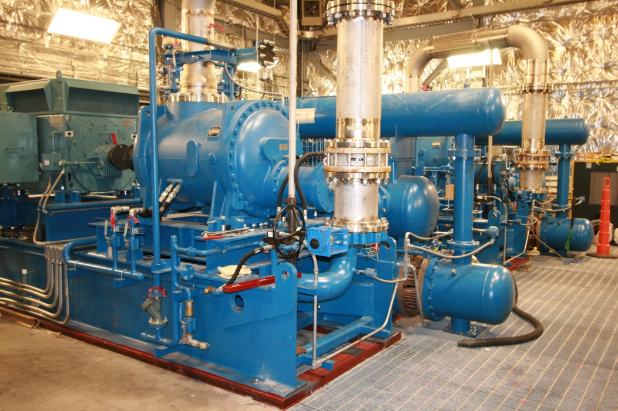
Standard Model Visual Comparison
Existing JLab CHL Compressors
New CHL 12 GeV Compressors
~2/3 of Original CHL Power and LN2 Needed

Slide 18
Helium Gas Recovery
Recover helium gas rather than use once through flow
Helium gas costs are increasing 15% per year
Growing demand for helium gas recovery and purification equipment among end users
Linde collaboration to develop standard helium purification recovery unit
Design completed and first article built for use in JLab’s 6 GeV accelerator

Slide 19
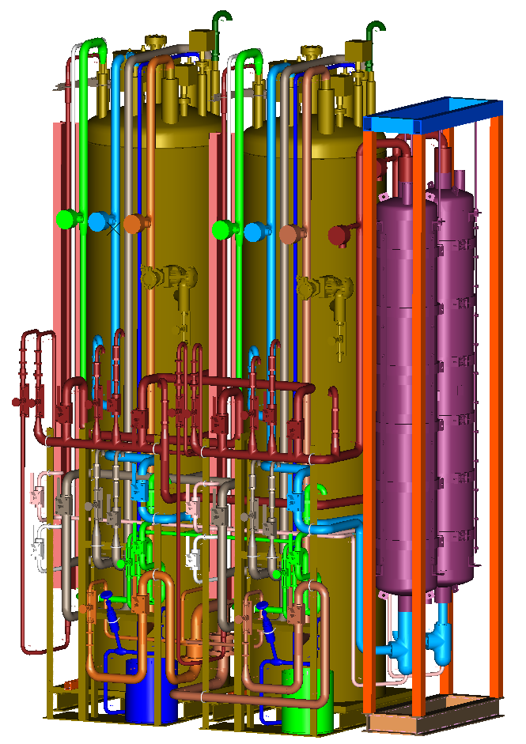
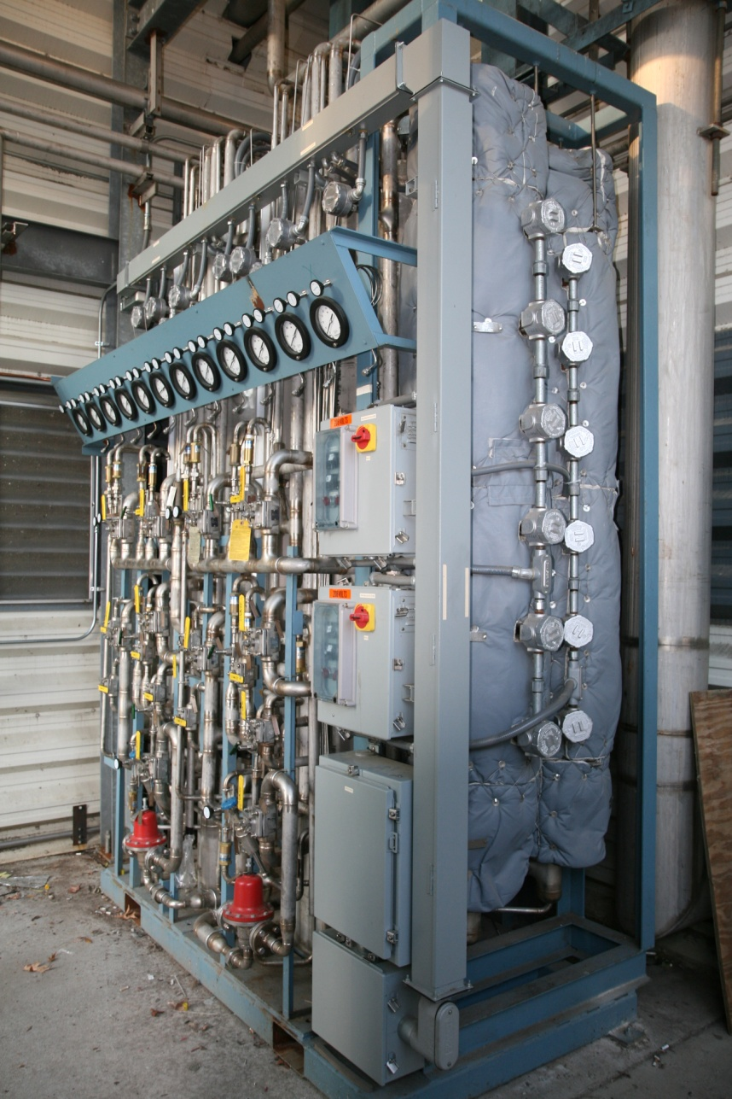
Linde Funded Purifier Development
Masters Thesis Project:
Mat Wright (JLab)
JLab Advisor: Rao Ganni (JLab)

Slide 20
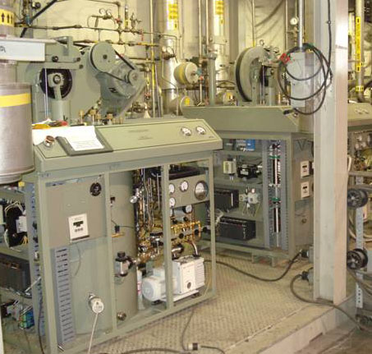
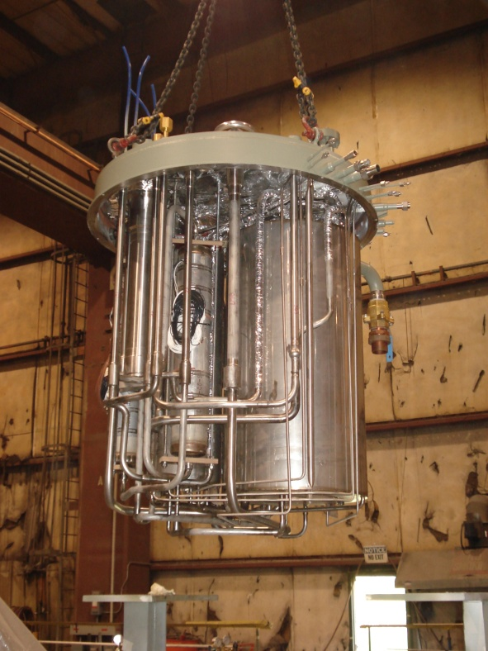
Industry Funded R+D Collaboration
Linde Model 1600 “standard” refrigerator (Funded by Linde)
  Normally 100-200KW electric utility use
  Standard for laboratory DOE / University Investigations and Experimentation
  Efficiency/Capacity of refrigeration and liquefaction improvement
  JLab focused on the refrigerator heat exchanger design
Model 1600 Refrigerator
Internal Heat Exchangers

Slide 21
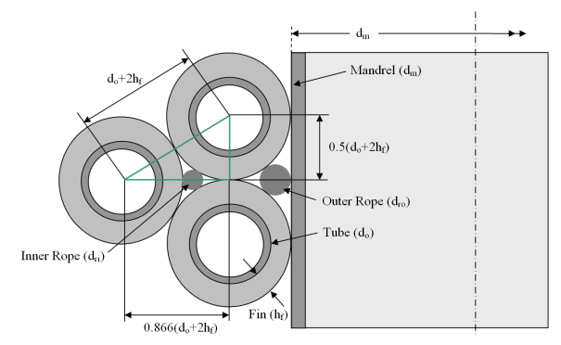
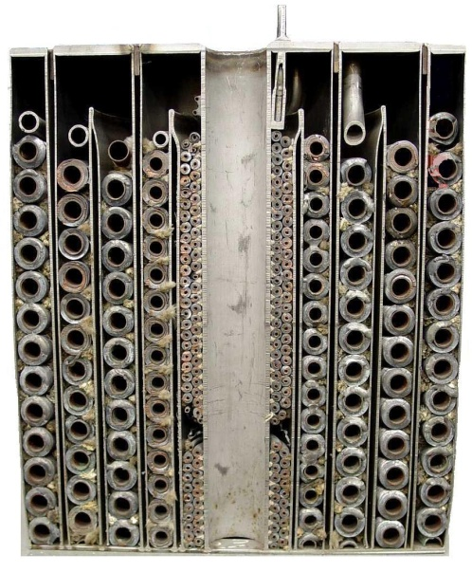
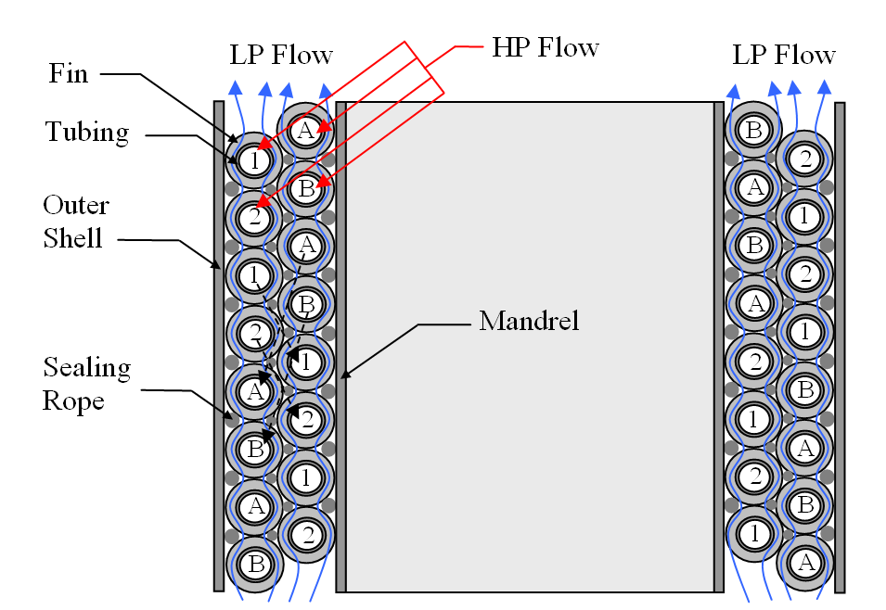
Linde Fin-Coil Heat Exchanger
3 Series of the Model 1600 Studied (1610/1620/1630)
2 configurations per series (1 or 2 compressors)
3 New Exchanger study options per configuration
Capacity & Efficiency comparisons
Masters Thesis:
Errol Yuksek (Jlab)
Jlab Advisor: Rao Ganni (Jlab)

Slide 22
Linde Test Results
Increased Capacity ( %) PLUS efficiency (% of Carnot)
Tested Results by Linde was…
25-30% increase capacity with same compressors

Slide 23
Summary
A JLab patented helium refrigerator process (Ganni Cycle) is being used more and more for other US applications
JLab project and outside collaborations is used to retain and develop both engineering staff and needed laboratory technology
The cycle has demonstrated positive effects for repair, maintenance, operation, and capital equipment cost for JLab and other laboratory cryogenic plants
A standard model has been developed for warm helium screw compressors to reduce cost and improve efficiency for the Physics research user community. Compressors have been built for NASA and 12 GeV
To support the growing need for helium gas conservation, a standard purification system has been developed and is being built to support 6 GeV and later 12 GeV operations, now available through industry to other DOE laboratories

